Slide 1
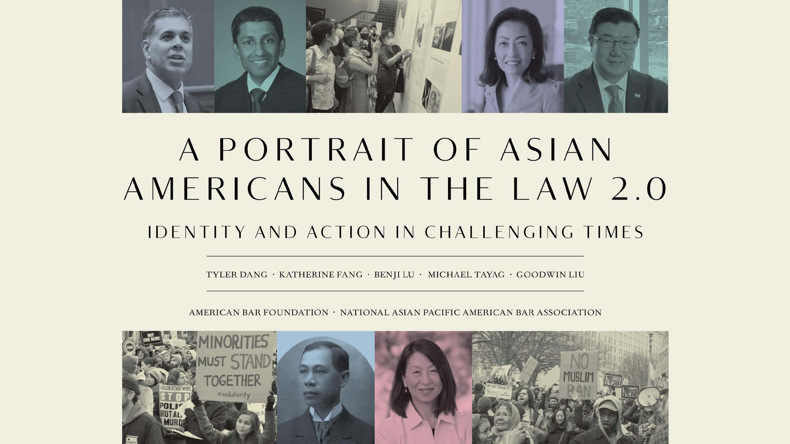

Slide 2
Acknowledgments
The Portrait Project received generous support from the American Bar Foundation, National Asian Pacific American Bar Association, the Oscar M. Ruebhausen Fund and Dean Heather Gerken at Yale Law School, and Northwestern University Pritzker School of Law. The project also received financial support from the Asian American Bar Association–Bay Area, Asian American Bar Association of New York, Asian American Law Fund of New York, Asian Pacific American Bar Association–Silicon Valley, Arnold & Porter, Davis Polk, Davis Wright Tremaine, Haynes & Boone, Latham & Watkins, Silvia Chin, Carol F. Lee, and an anonymous donor.

Slide 3
Main findings
Asian American attorneys indicated greater engagement with social and political issues, along with a desire to change and improve society.
Underrepresentation of Asian Americans in the top ranks of the legal profession persists. But there has been progress among federal judges and general counsel, and law school enrollment has rebounded somewhat from a 20-year low.
Greater institutional support would likely reduce barriers to advancement and improve the professional lives of Asian American attorneys.

Slide 4
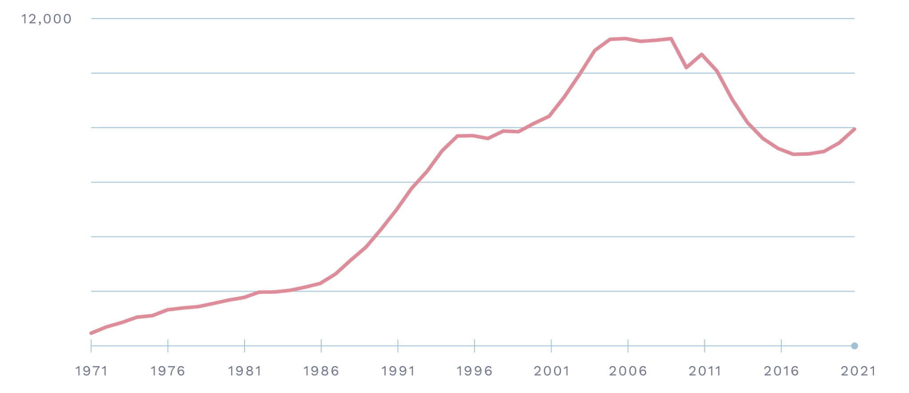
Asian or Pacific Islander JD Enrollment, 1971–2021
SOURCE: American Bar Association

Slide 5
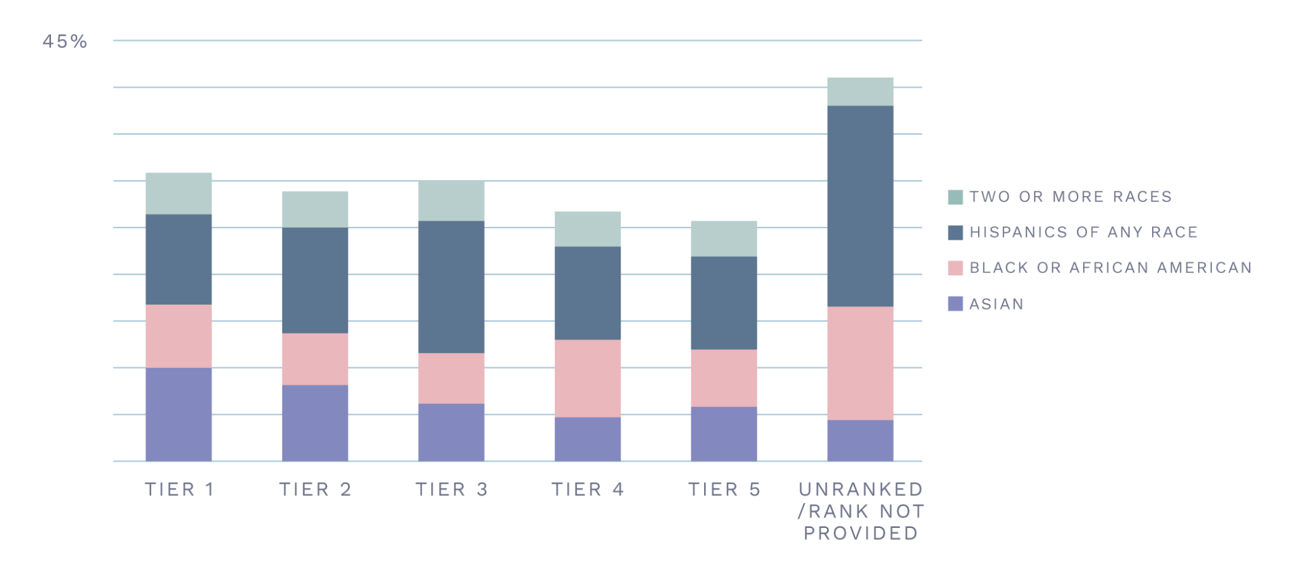
Minority Percentage of Total JD Enrollment by Tier, 2021
SOURCE: American Bar Association; U.S. News & World Report

Slide 6
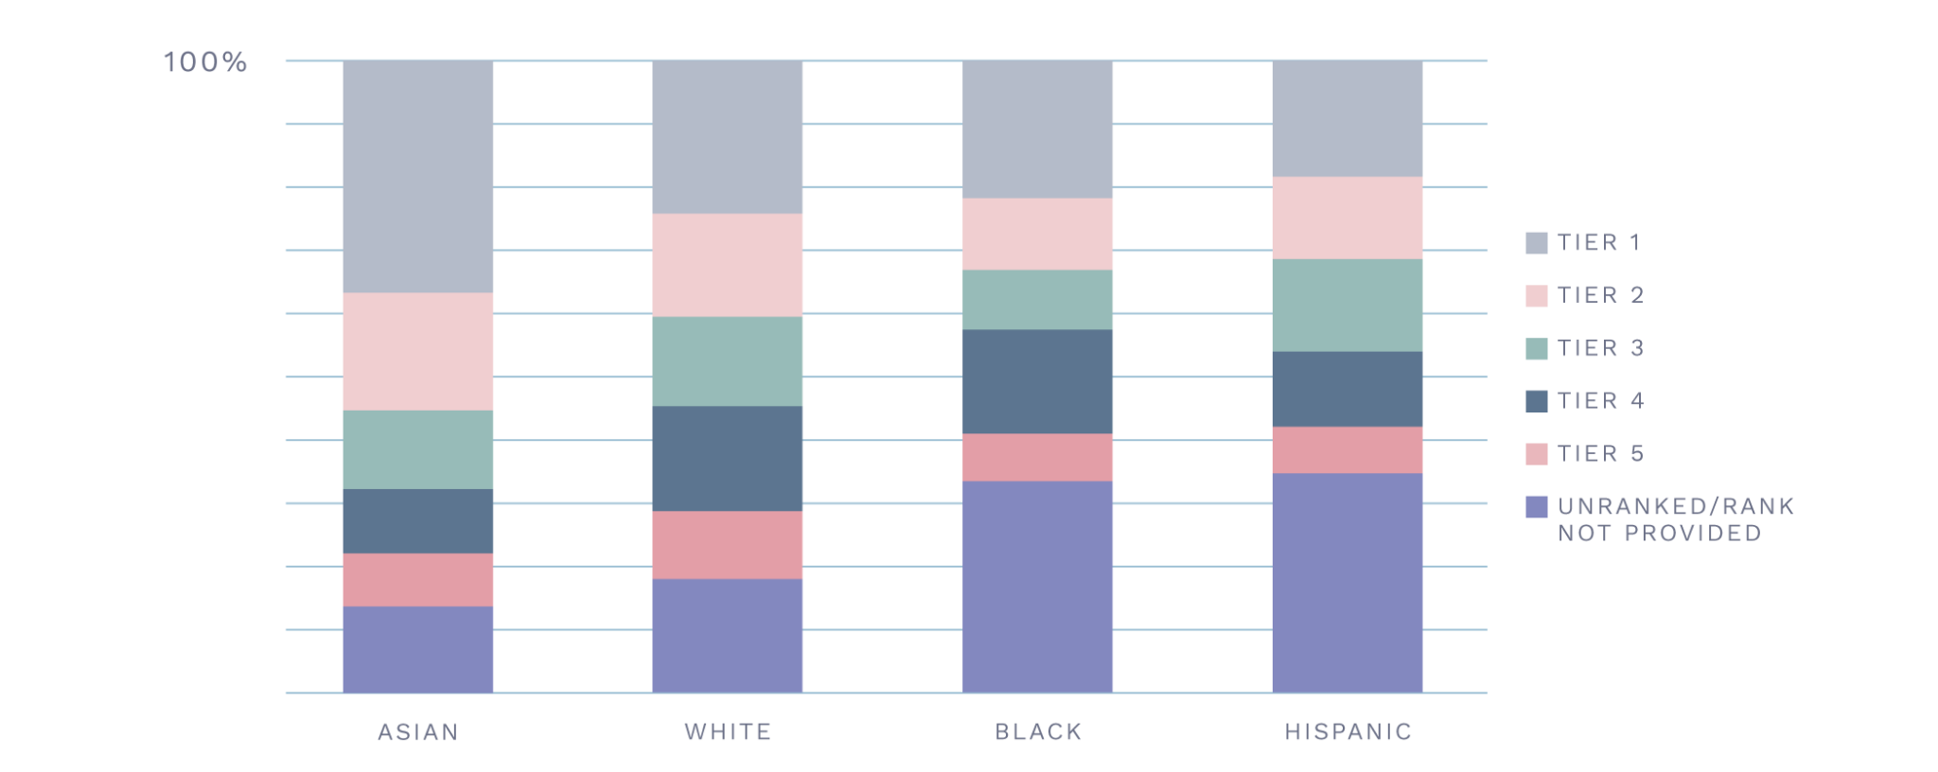
Distribution of Each Racial or Ethnic Group Across Tiers, 2021
SOURCE: American Bar Association; U.S. News & World Report

Slide 7
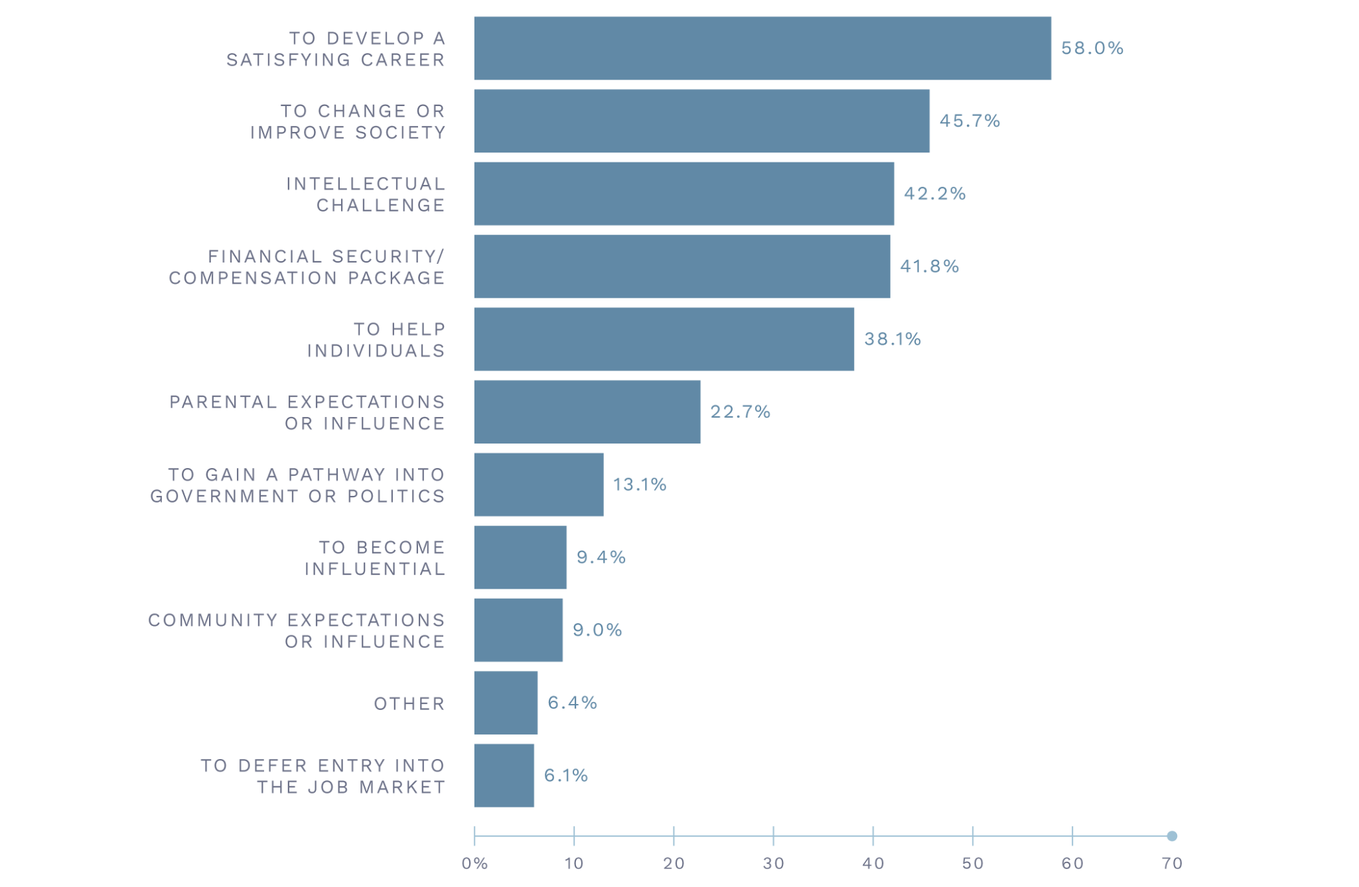
Top Three Reasons for Attending Law School
SOURCE: 2022 Portrait Project Survey

Slide 8
Minority Law Clerks in Federal Courts, 1993–2021
SOURCE: National Association for Law Placement

Slide 9
Minority Law Clerks in State Courts, 1993–2021
SOURCE: National Association for Law Placement

Slide 10
Top-30 Law School Graduates and Judicial Clerkships, 2021
SOURCE: American Bar Association; National Association for Law Placement; U.S. News & World Report

Slide 11
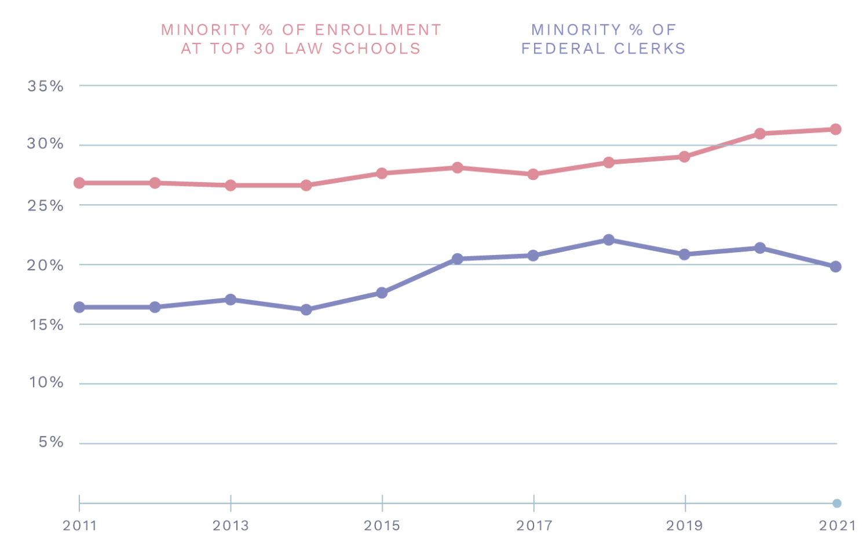
Minority Enrollment at Top 30 Law Schools of Respective Year vs. Percentage of
Federal Clerks, 2011–21
SOURCE: American Bar Association; National Association for Law Placement; U.S. News & World Report

Slide 12
Satisfaction with Mentorship Received in Law School
SOURCE: 2022 Portrait Project Survey

Slide 13
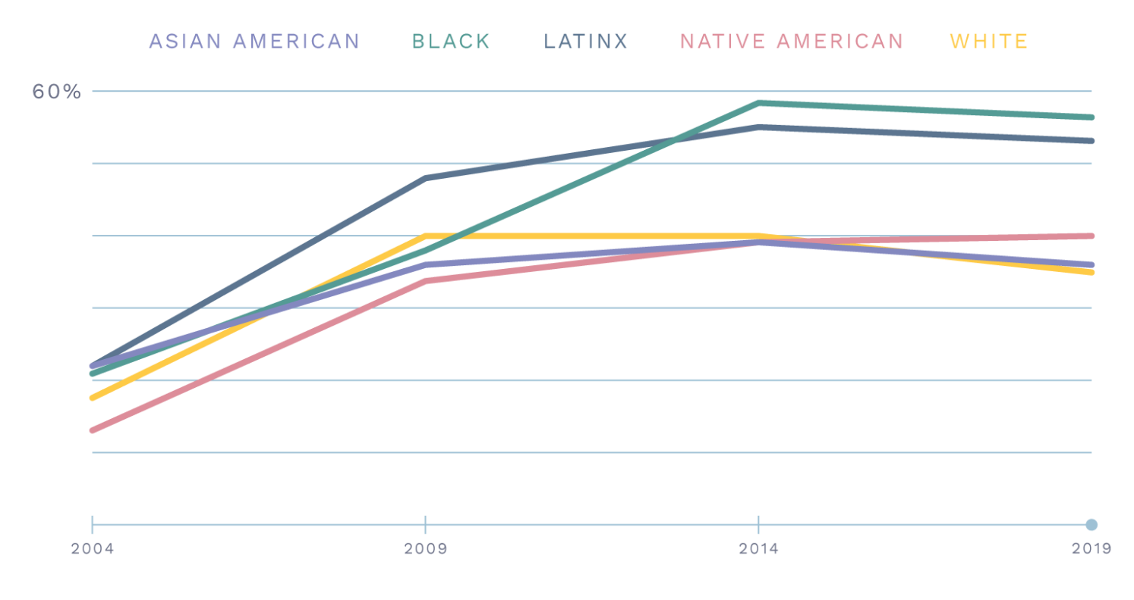
Students Expected to Owe Over $100k, by Year and Race
SOURCE: Law Student Survey of Student Engagement

Slide 14
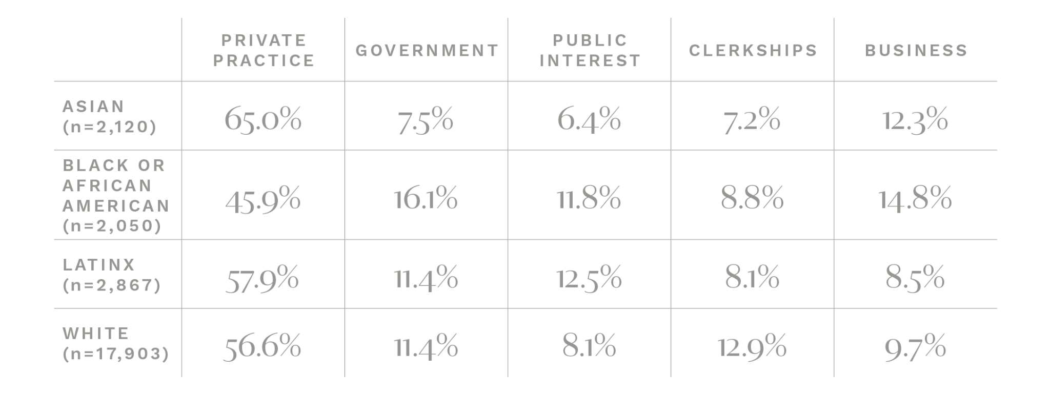
Employer Types by Race/Ethnicity, 2020
SOURCE: National Association for Law Placement

Slide 15
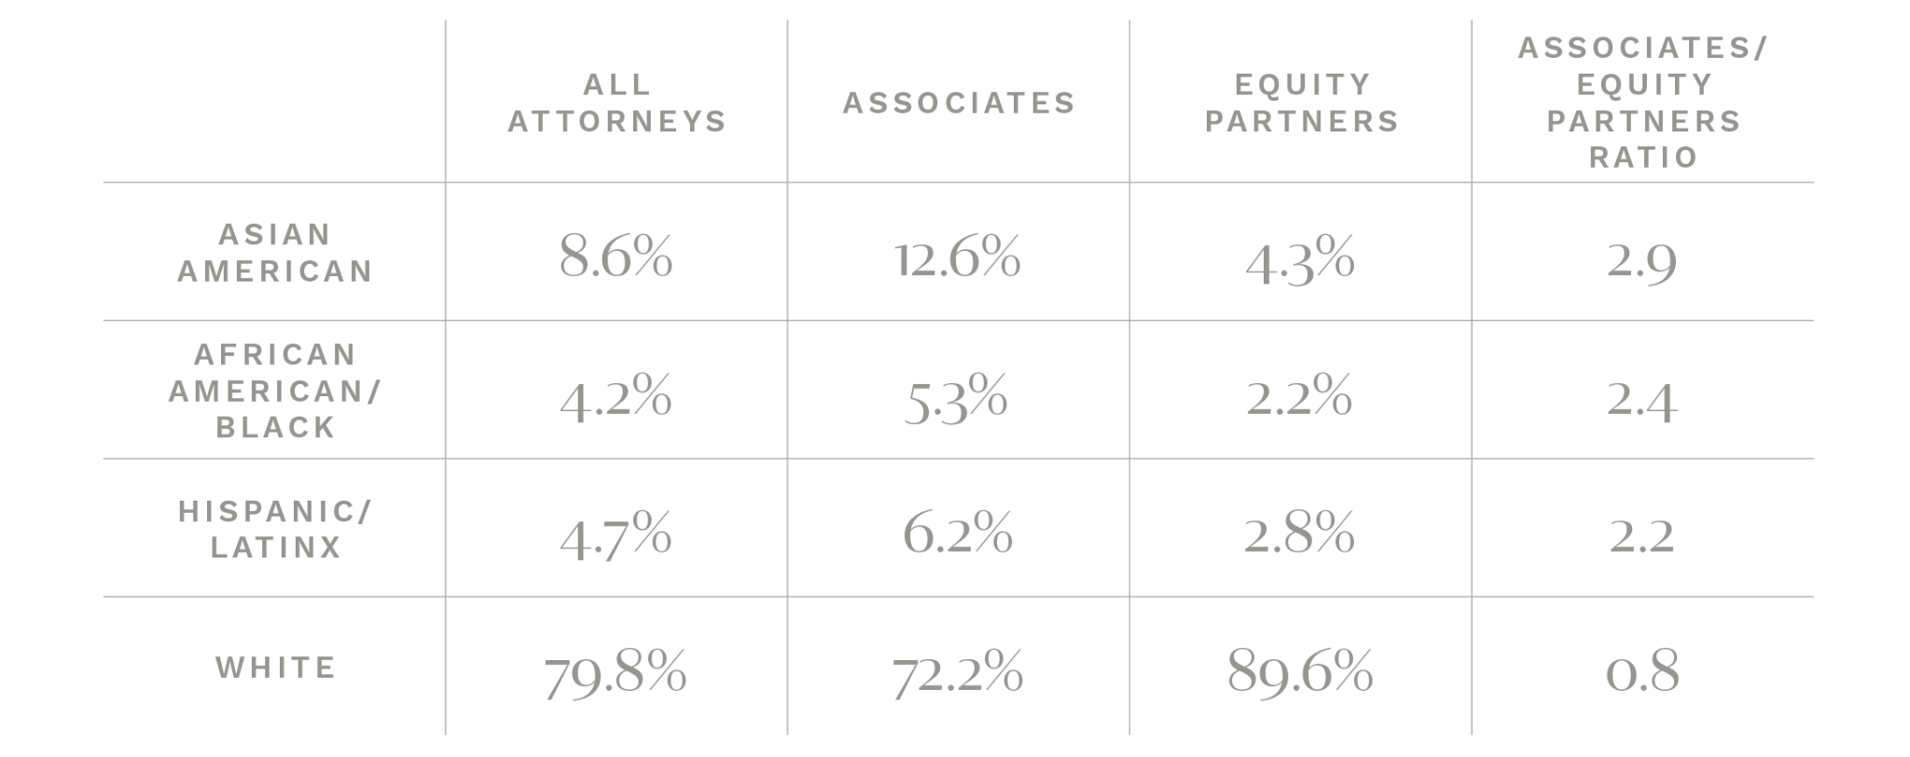
Demographics of Law Firms, 2020
SOURCE: Minority Corporate Counsel Association Diversity Survey Report

Slide 16
Percentage of Lawyers in Business Sector by Race/Ethnicity, 2012-13
SOURCE: American Bar Foundation; NALP Foundation for Law Career Research and Education

Slide 17
Employment Settings 12 Years into Practice Among Lawyers Who Were at Midsize
to Large Firms in Second Year of Practice, by Race/Ethnicity, 2012-13
SOURCE: American Bar Foundation

Slide 18
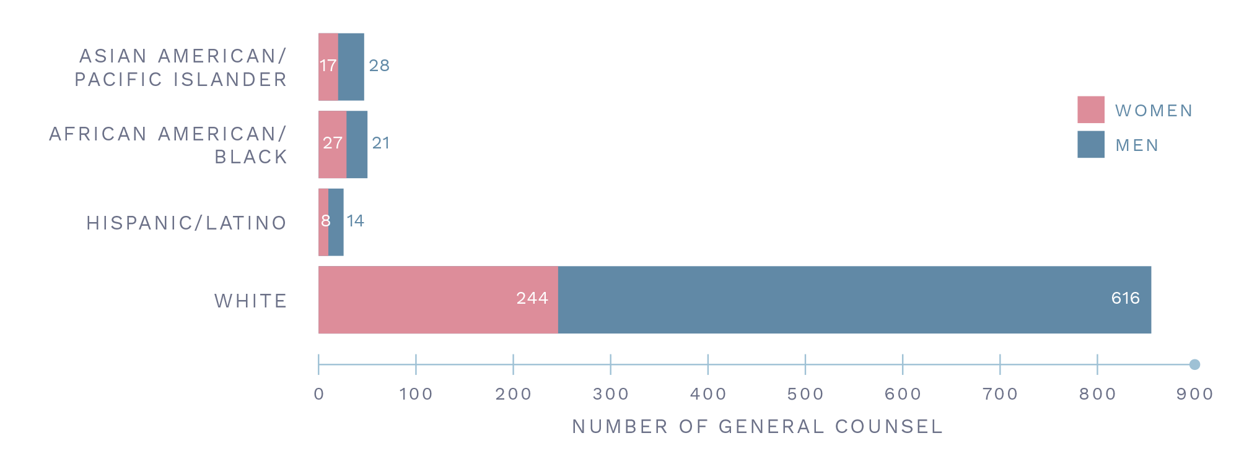
Demographics of Fortune 1000 General Counsels, 2020
SOURCE: Minority Corporate Counsel Association

Slide 19
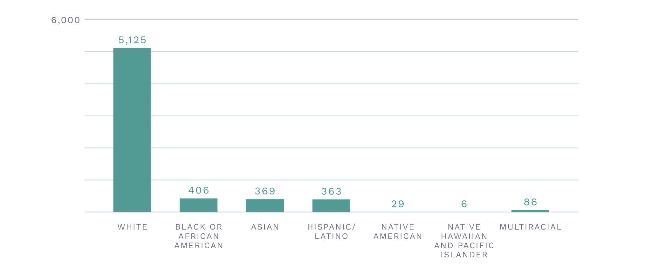
Demographics of Assistant U.S. Attorneys, 2021
SOURCE: Office of Personnel Management, Federal Workforce Data, Diversity Cubes Dec. 2021

Slide 20
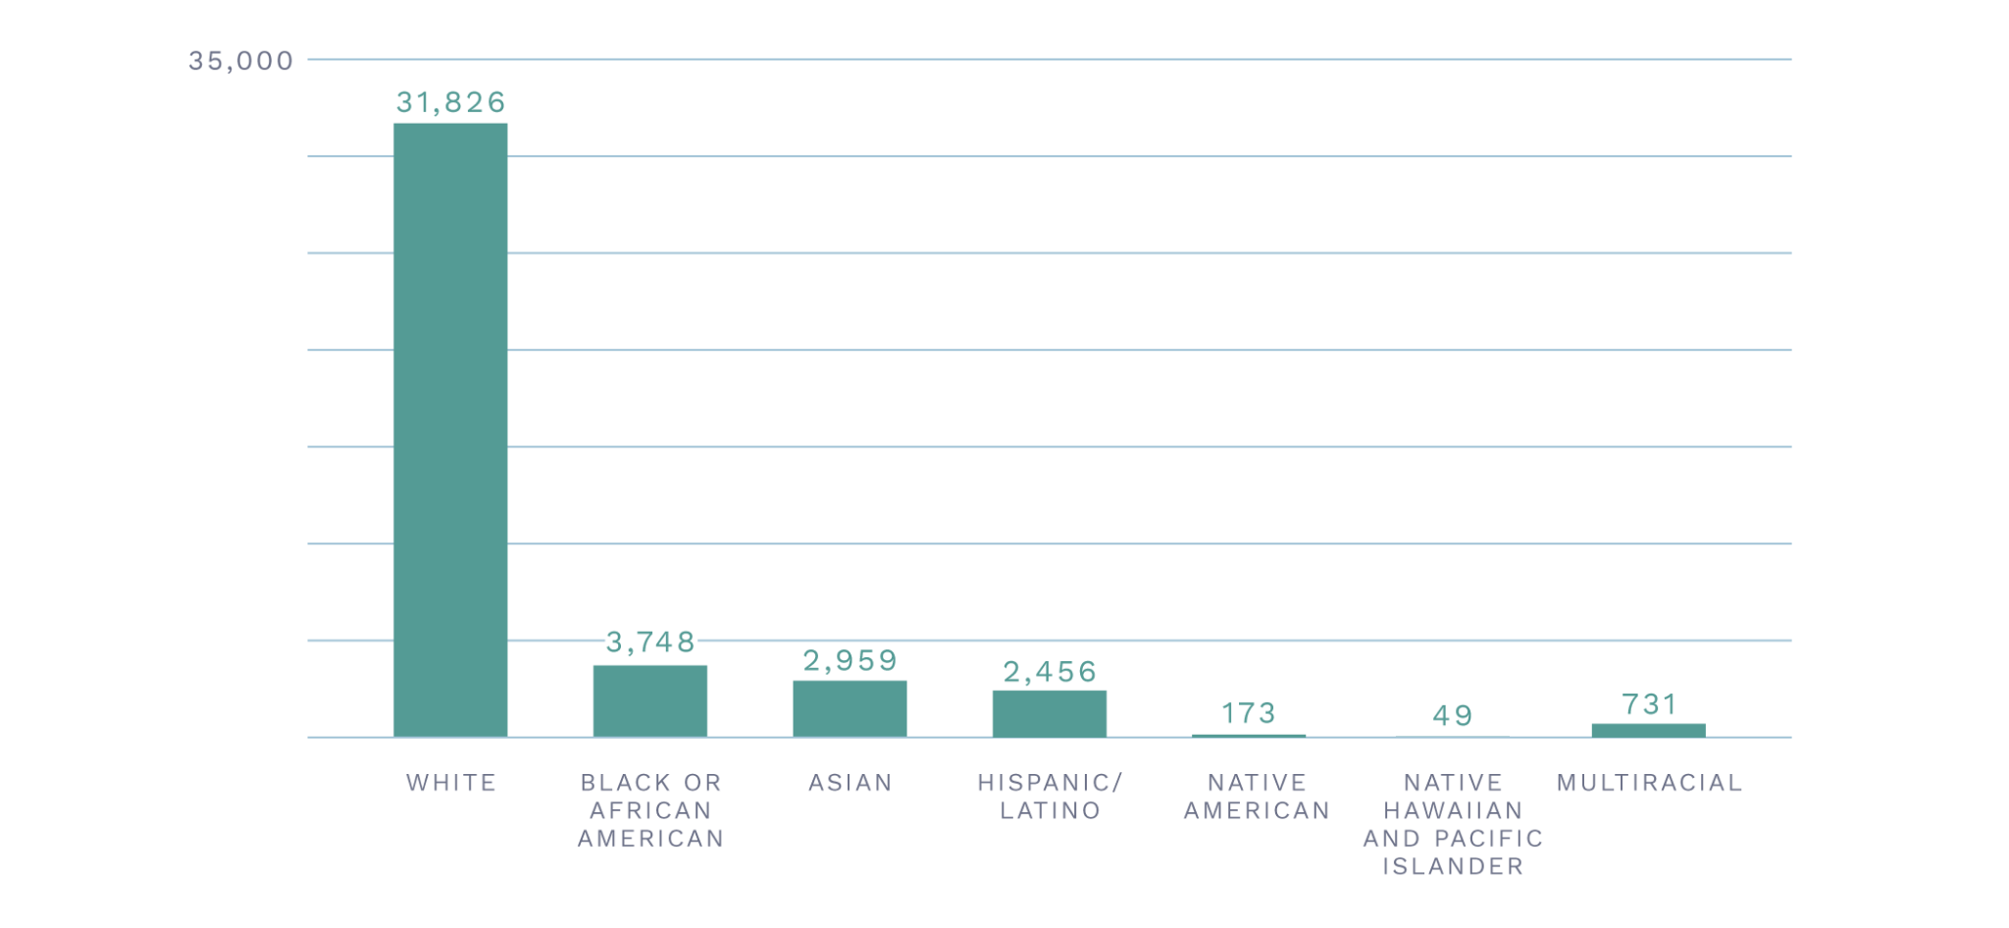
Demographics of “General Attorneys” in the U.S. Government, 2021
SOURCE: Office of Personnel Management, Federal Workforce Data, Diversity Cubes Dec. 2021

Slide 21
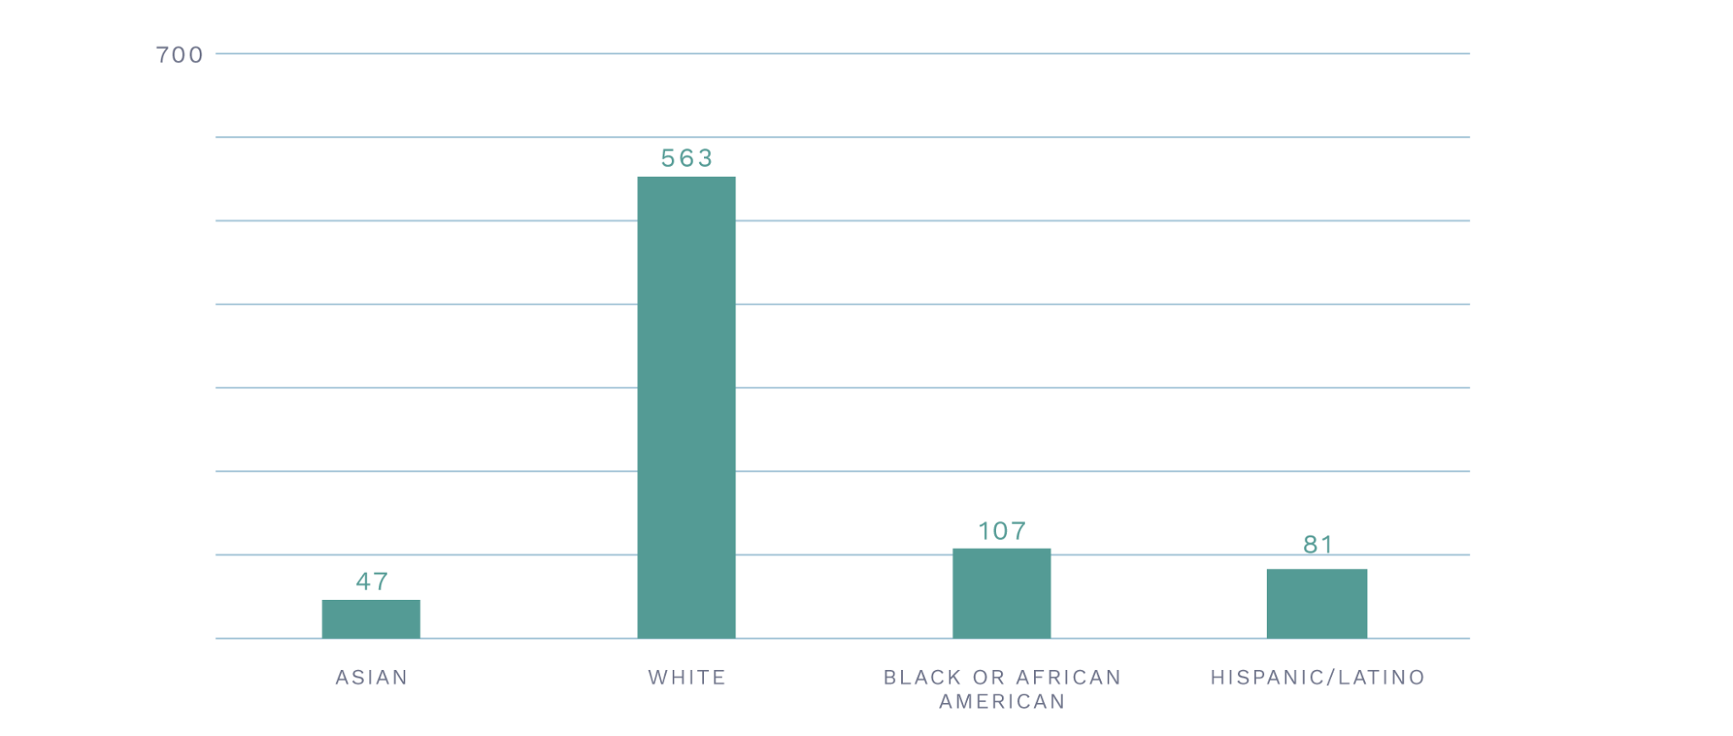
Federal Judges, 2022
SOURCE: Federal Judicial Center

Slide 22
Federal Judges, 2022
SOURCE: Federal Judicial Center

Slide 23
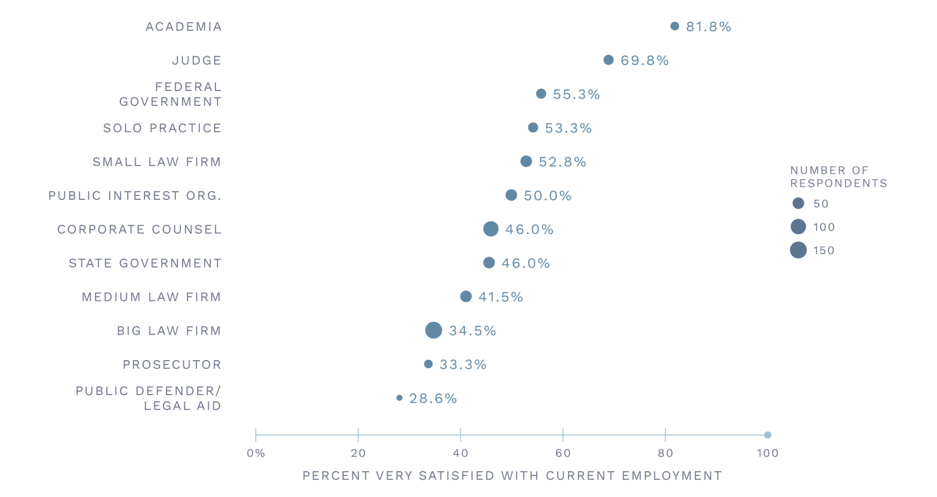
Satisfaction with Current Employment by Practice Setting
SOURCE: 2022 Portrait Project Survey

Slide 24
8
of 2,396 elected prosecutors in the United States in 2019 were Asian Americans
SOURCE: Women’s Donor Network, PP 2.0

Slide 25
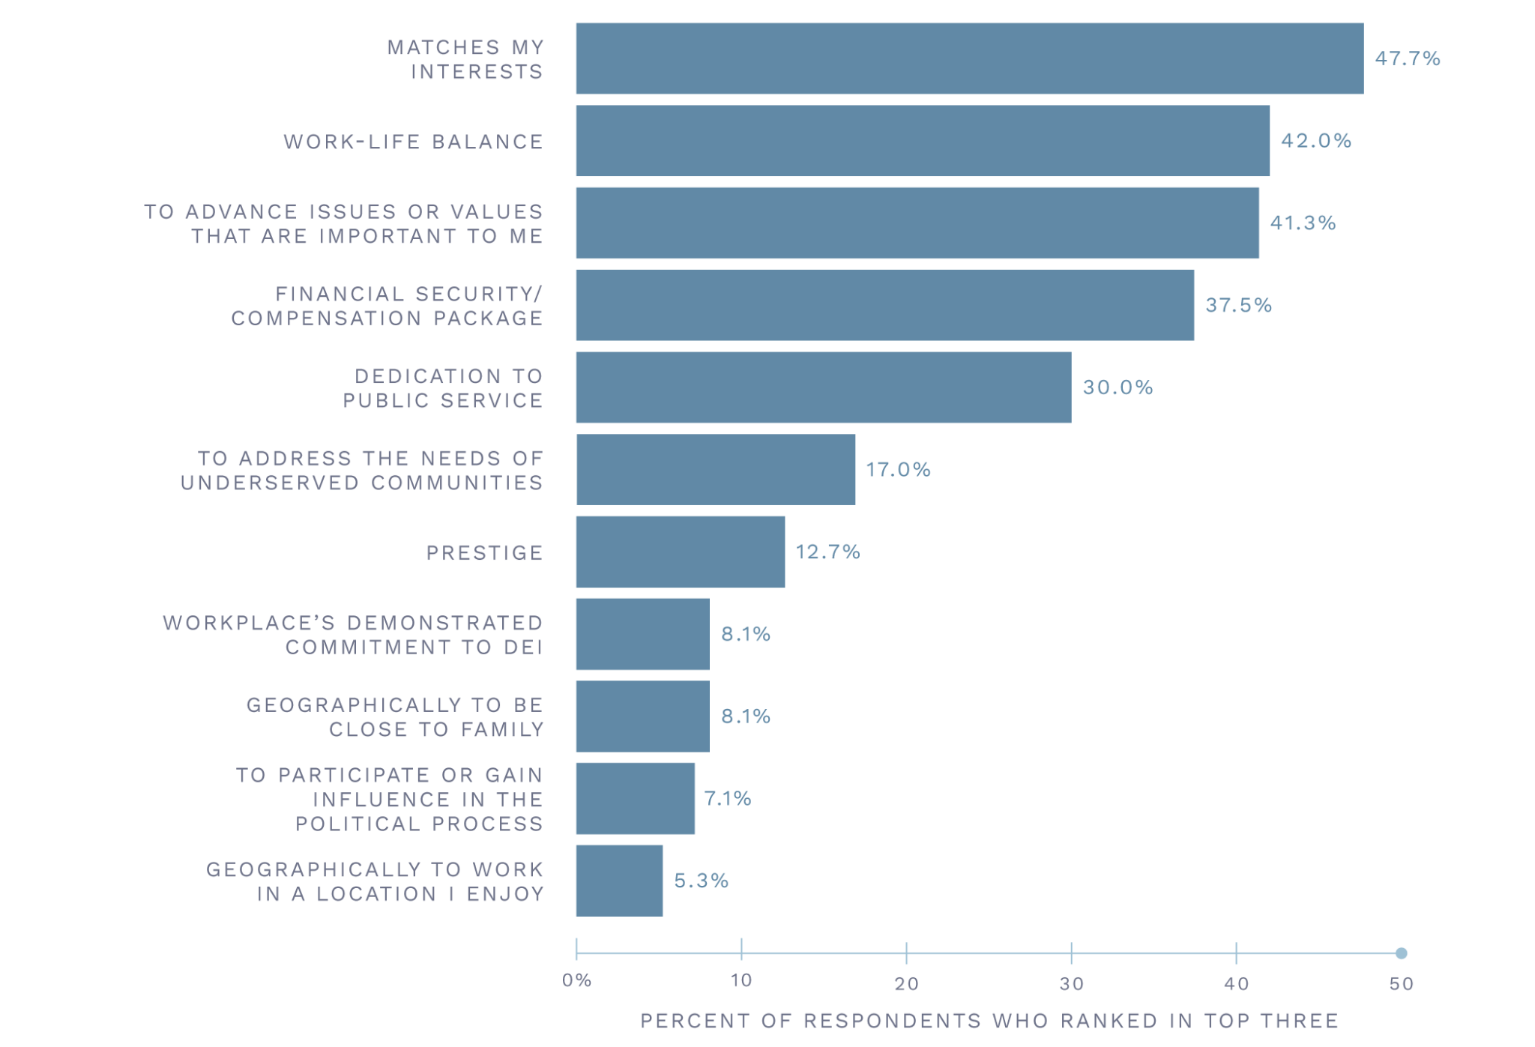
Motivations for Changing Practice Settings
SOURCE: 2022 Portrait Project Survey

Slide 26
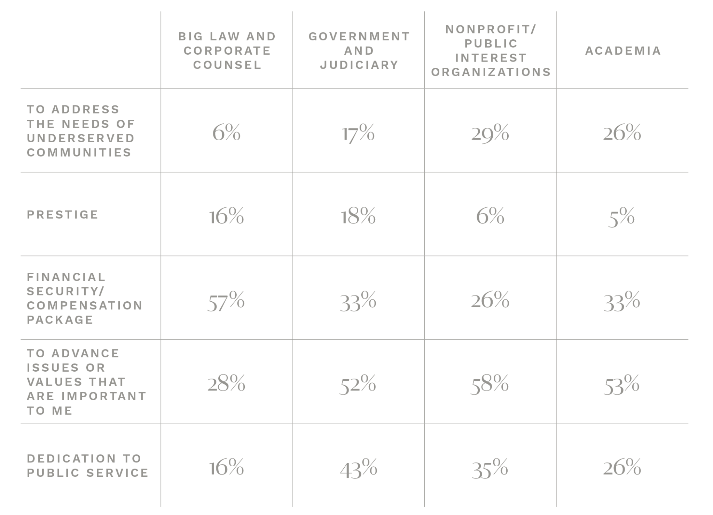
Motivations for Changing to Specific Practice Settings
This figure shows, for each practice setting and reason for changing settings, the percentage of respondents desiring that practice setting who cited the reason among their three most significant.
SOURCE: 2022 Portrait Project Survey

Slide 27
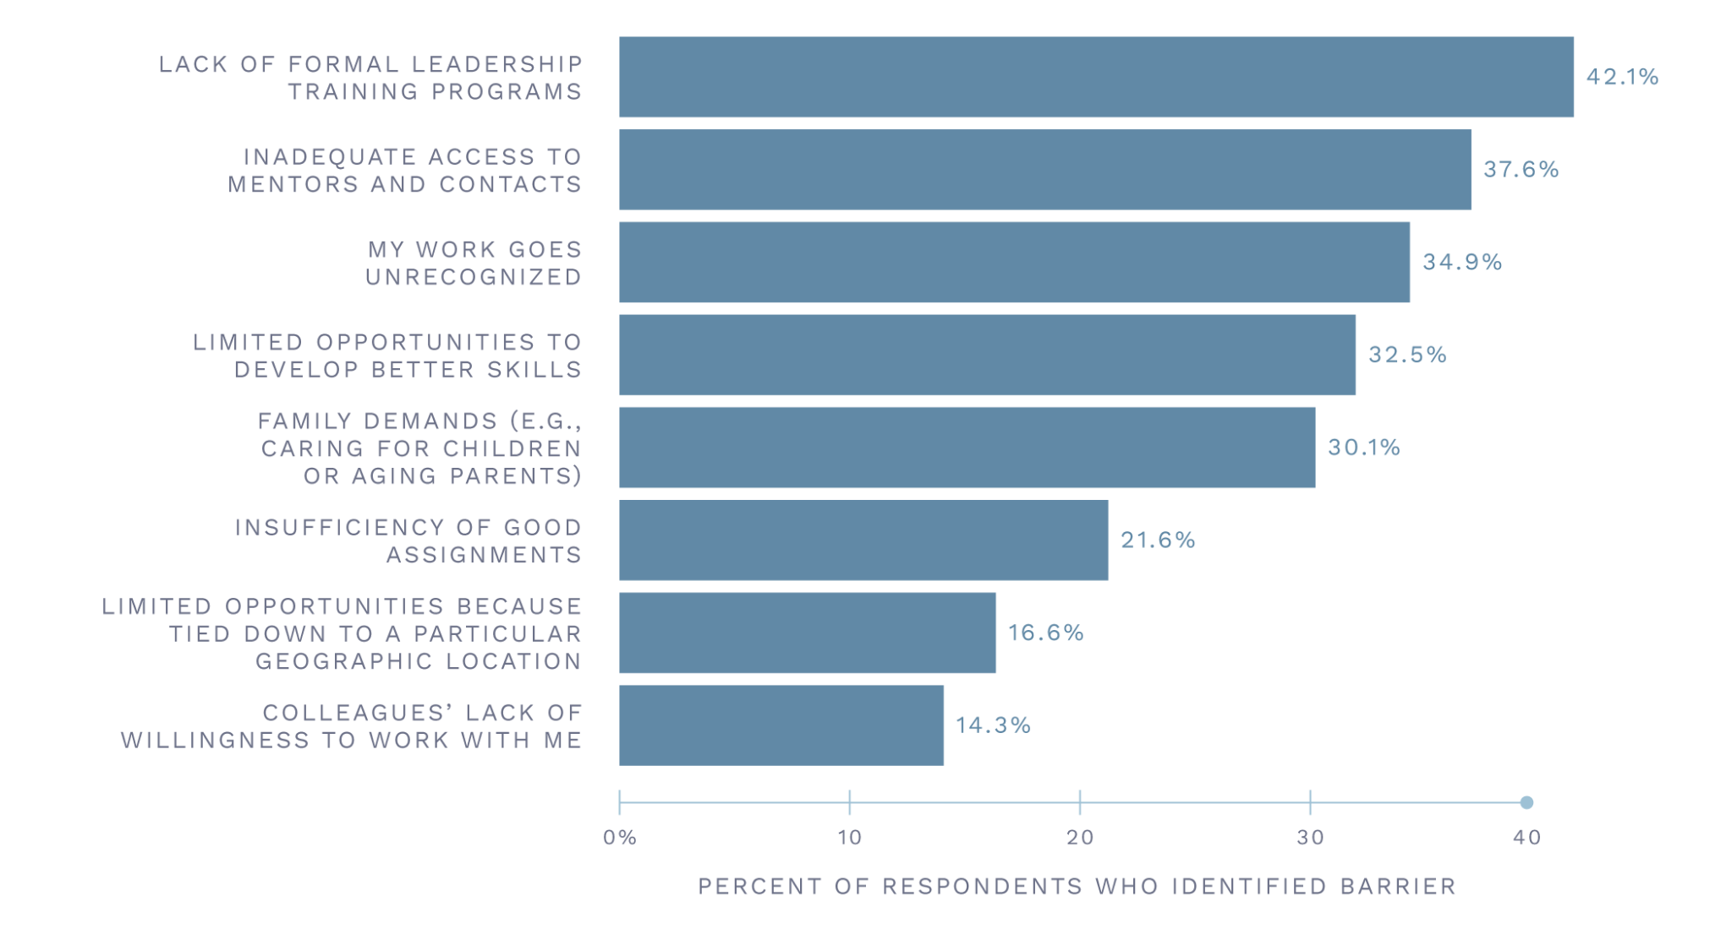
Perceived Barriers to Career Advancement
SOURCE: 2022 Portrait Project Survey

Slide 28
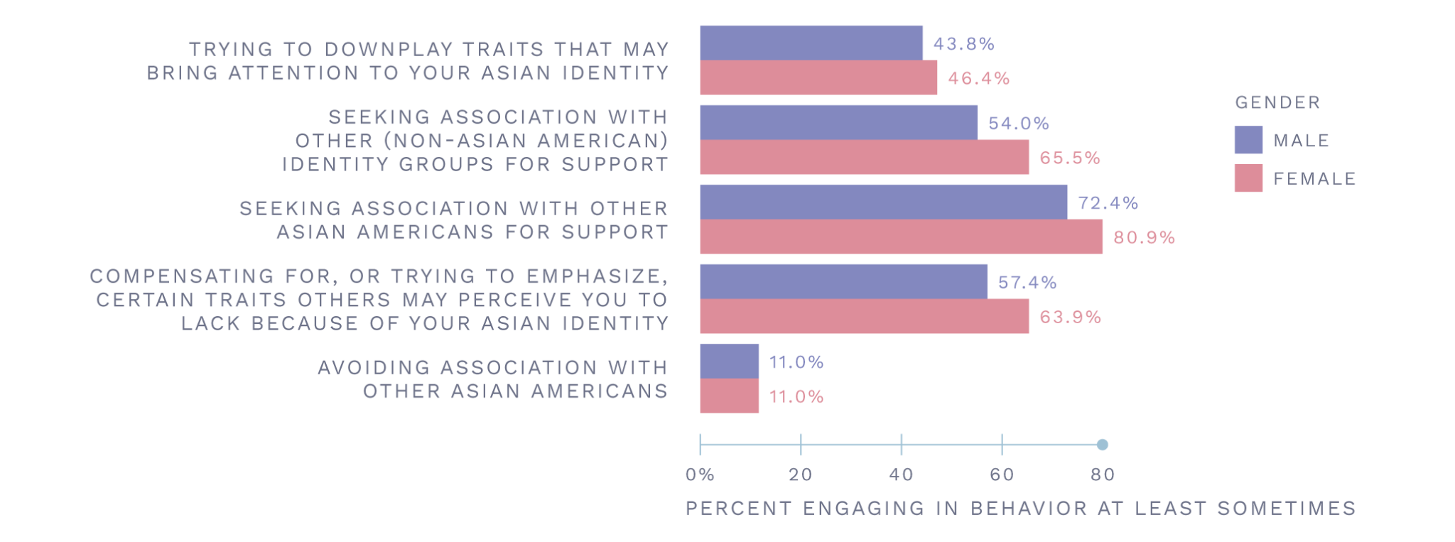
Workplace Behaviors
SOURCE: 2022 Portrait Project Survey

Slide 29
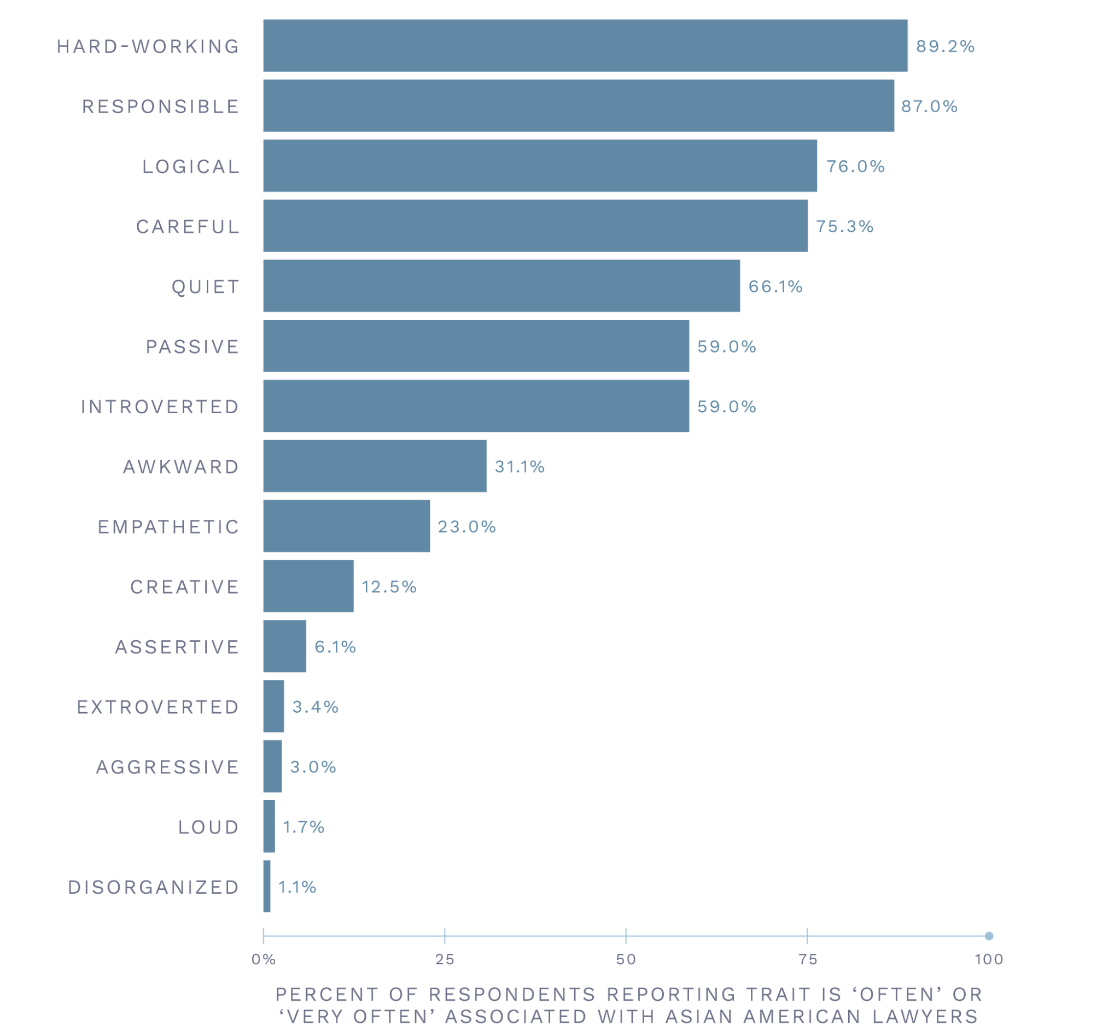
Traits Associated with Asian American Lawyers
SOURCE: 2022 Portrait Project Survey

Slide 30
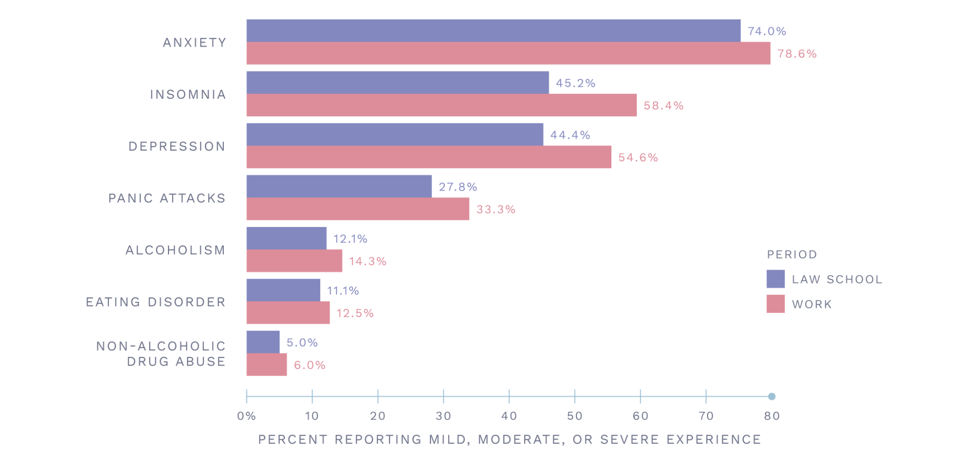
Mental Health Challenges
SOURCE: 2022 Portrait Project Survey

Slide 31
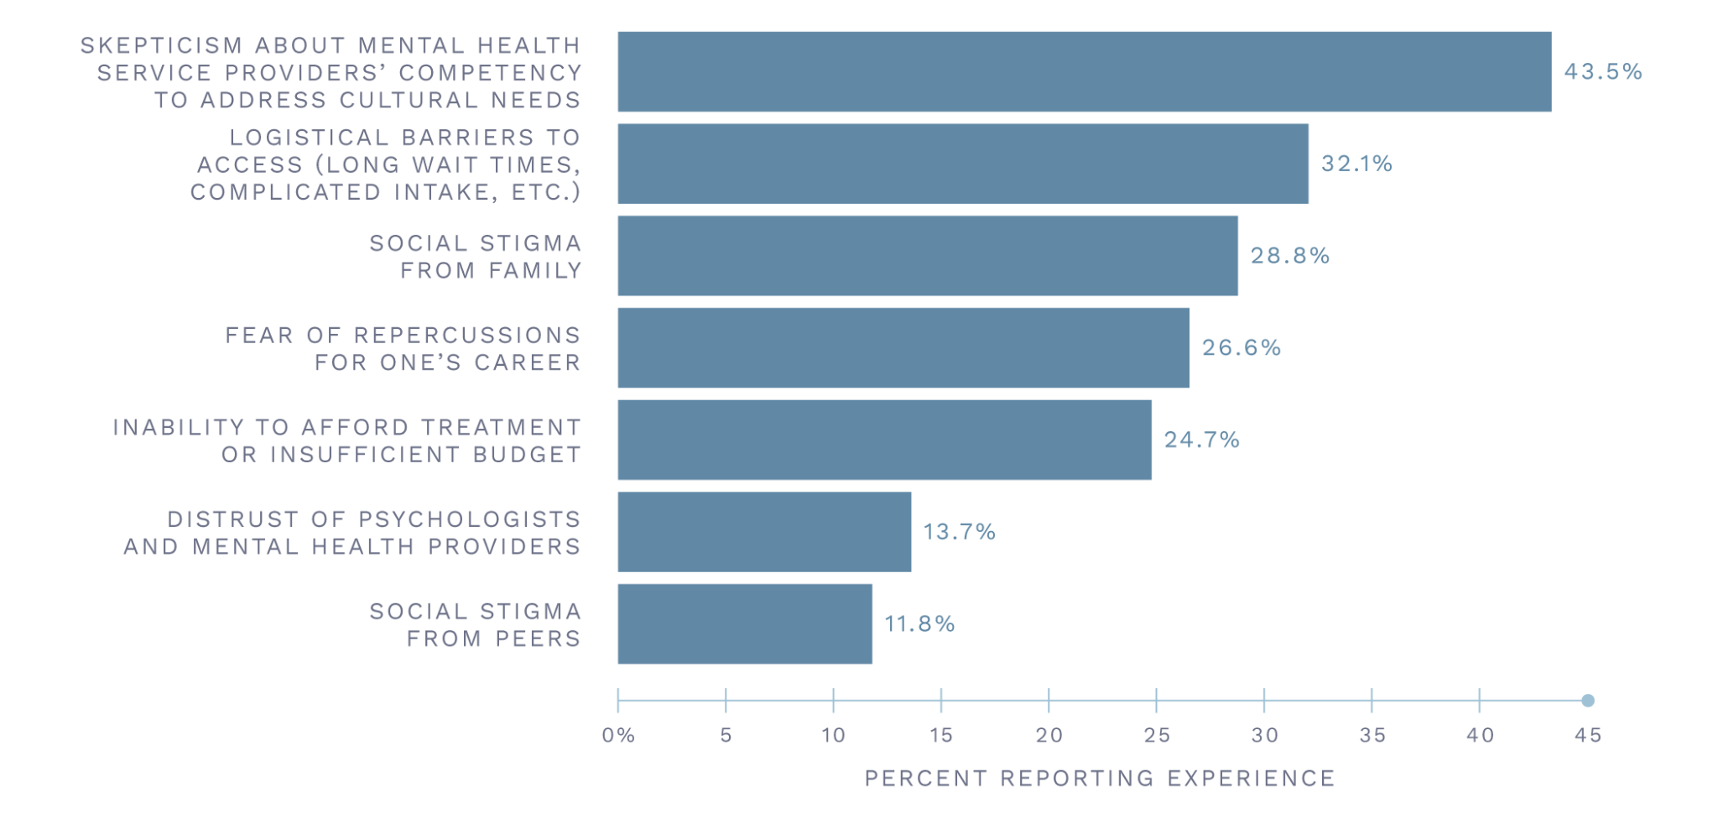
Experiences While or as a Result of Seeking Mental Health Treatment
SOURCE: 2022 Portrait Project Survey

Slide 32
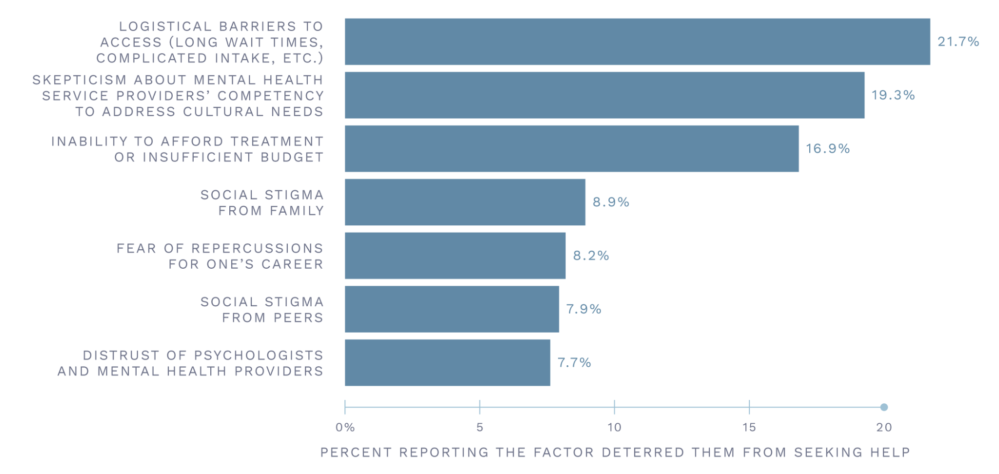
Reasons for Not Seeking Mental Health Treatment
SOURCE: 2022 Portrait Project Survey

Slide 33
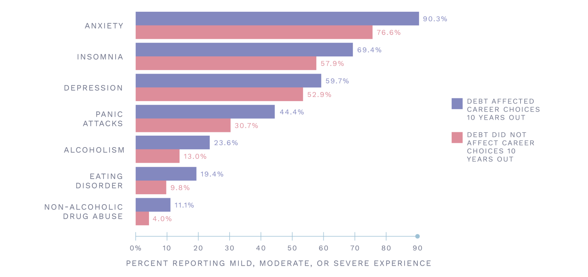
Mental Health Challenges by Debt Burden
SOURCE: 2022 Portrait Project Survey

Slide 34
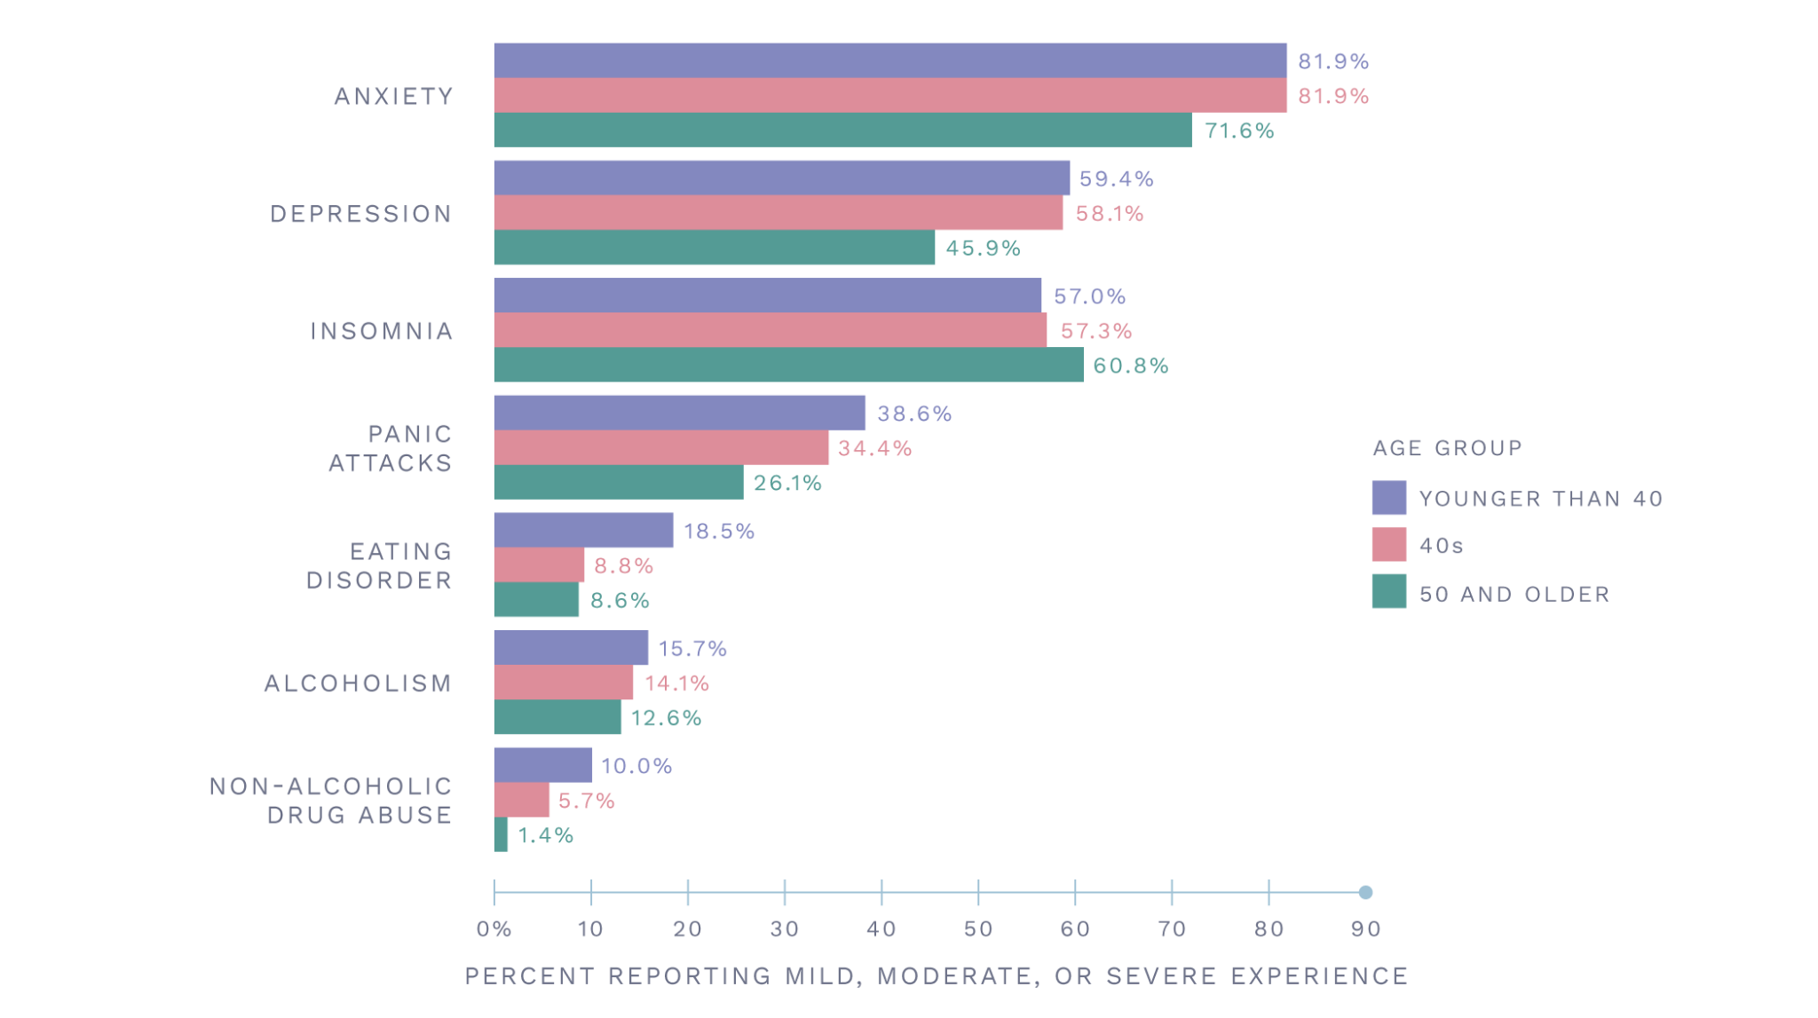
Mental Health Challenges by Age
SOURCE: 2022 Portrait Project Survey

Slide 35
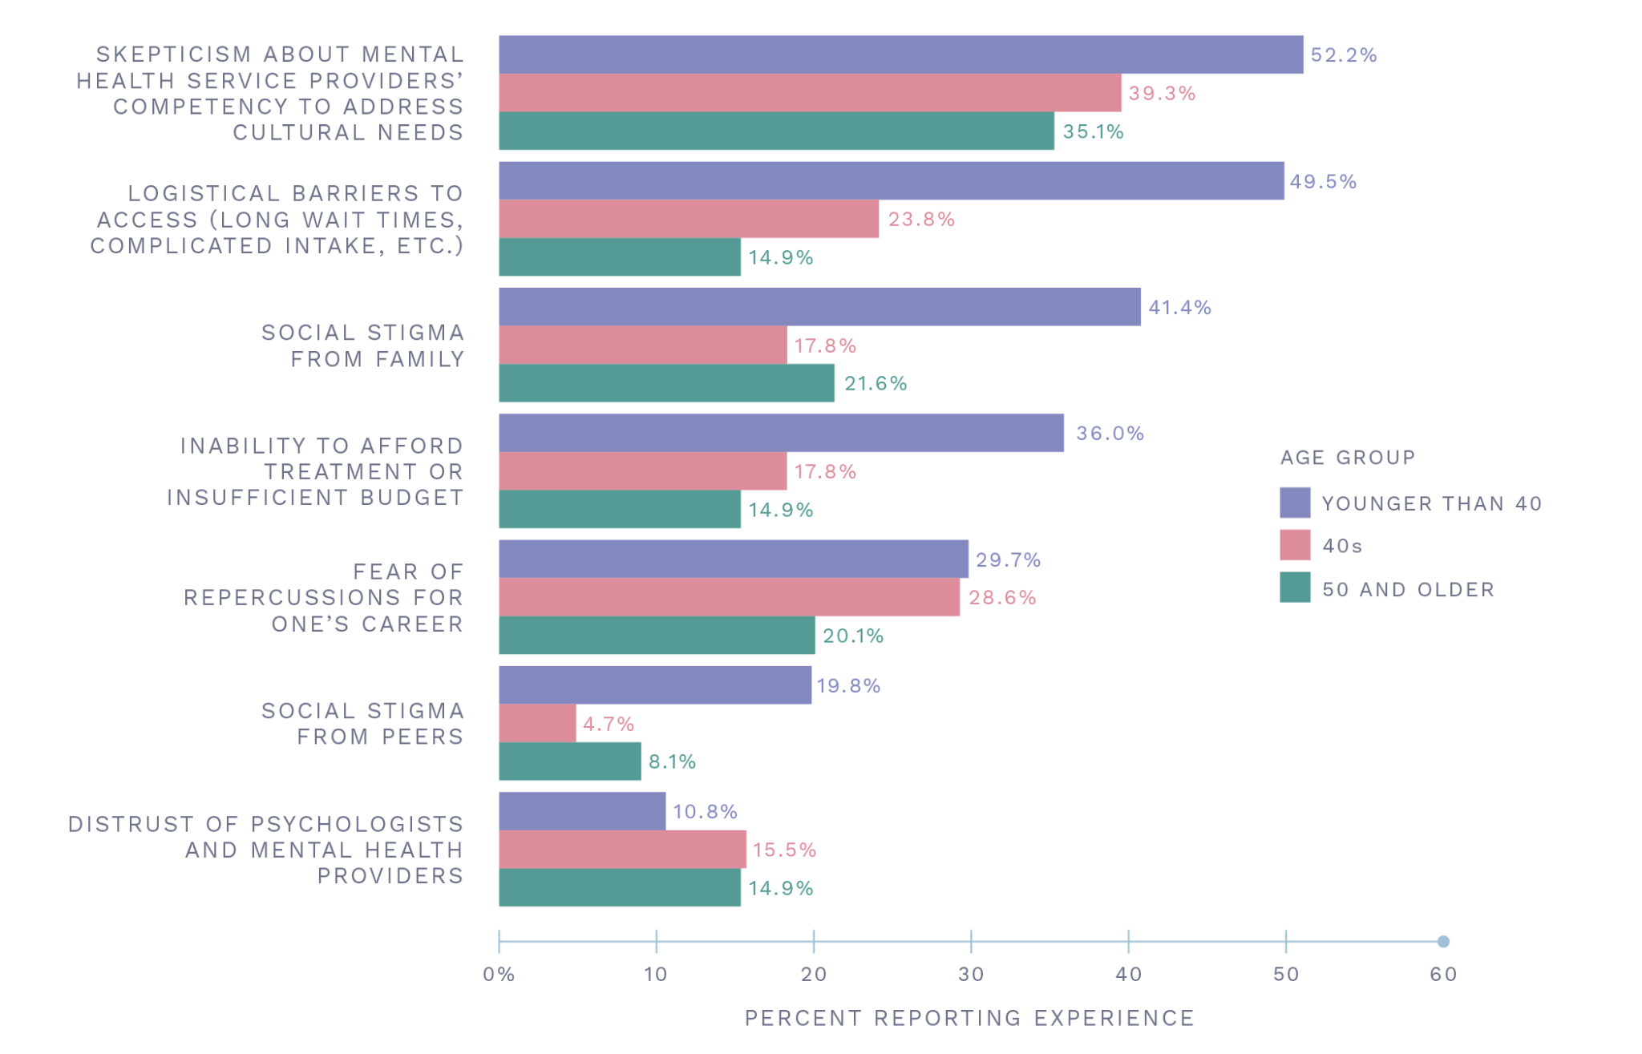
Experiences While or as a Result of Seeking Mental Health Treatment by Age
SOURCE: 2022 Portrait Project Survey

Slide 36
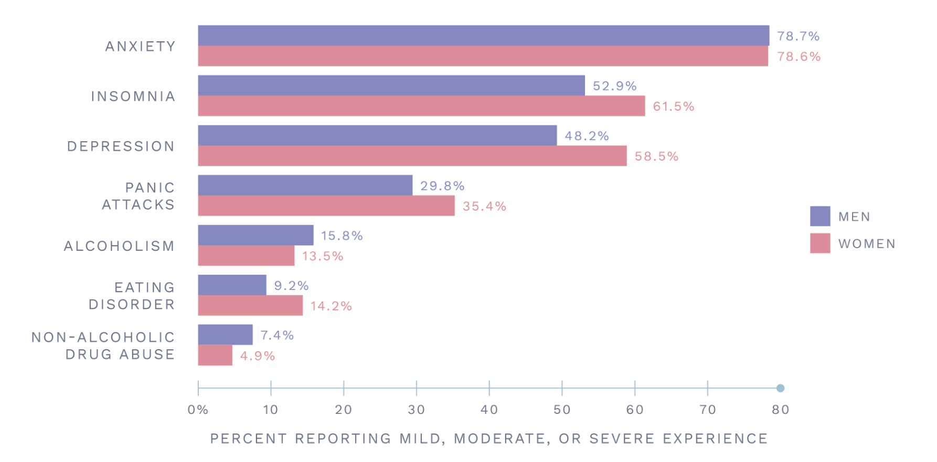
Mental Health Challenges by Gender
SOURCE: 2022 Portrait Project Survey

Slide 37
Change in Professional Activities from March 2020
SOURCE: 2022 Portrait Project Survey

Slide 38
Change in AAPI Activities from March 2020
SOURCE: 2022 Portrait Project Survey

Slide 39
Change in Advocacy or Support for Black Community Since March 2020
SOURCE: 2022 Portrait Project Survey

Slide 40
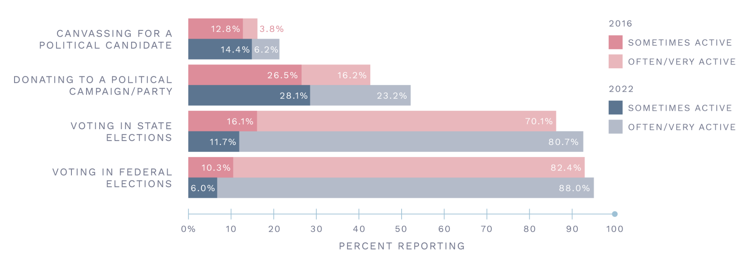
Political Activity
SOURCE: 2022 Portrait Project Survey

Slide 41
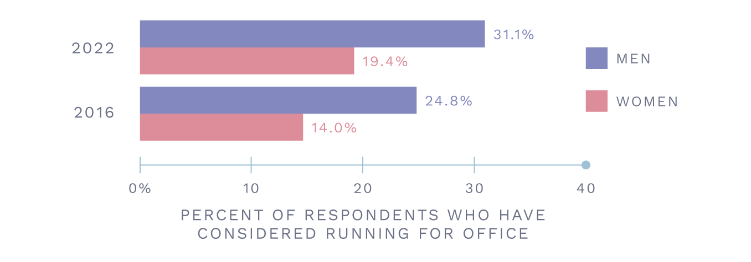
Thoughts About Running for Office
SOURCE: 2022 Portrait Project Survey

Slide 42
Satisfaction with Workplace Support
SOURCE: 2022 Portrait Project Survey

Slide 43
Perceptions of Physical Safety
SOURCE: 2022 Portrait Project Survey

